Slide 1

PUSH BUTTON
GET DEVELOPMENT ENVIRONMENT
Dev Containers in Action

Slide 2


Adam Barney
Staff Software Engineer, Rocket Mortgage
adambarney@rocketmortgage.com
@cabarney

Slide 3

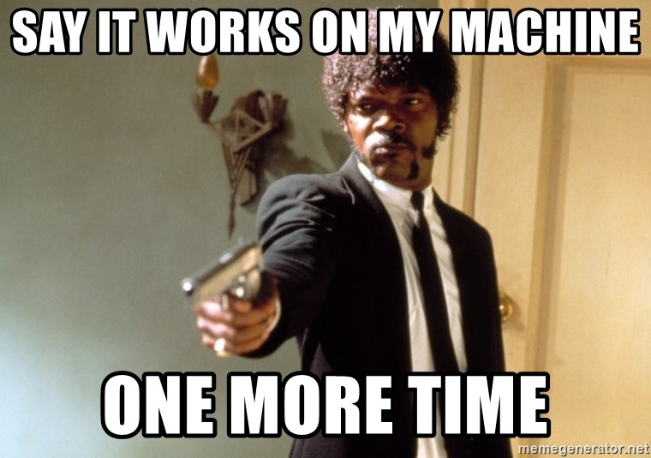
What problem are we solving?

Slide 4
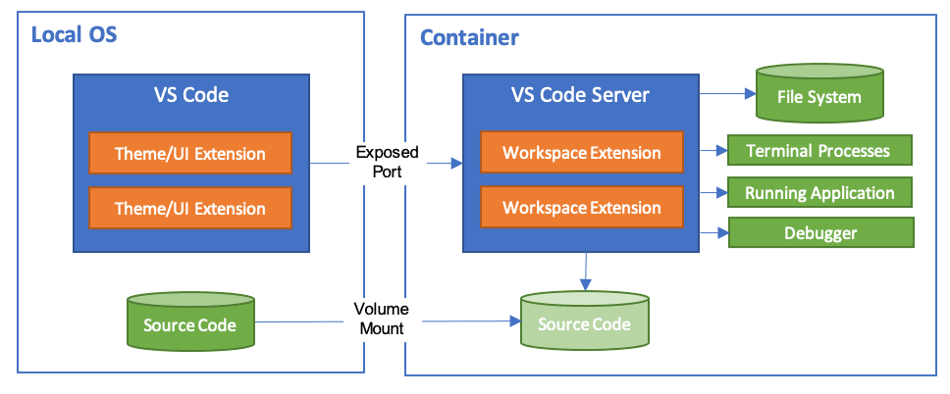
The solution: DevContainers
Image from: https://code.visualstudio.com/docs/remote/containers

Slide 5

What can I do?
Notes:
Play with a new language / framework without installing it
Create a consistent, standard environment for collaboration
Enterprise
Open-Source projects
Ease the process of onboarding new engineers
Explore Pull Requests for repos you don’t actively work on

Slide 6

Let’s see it in action!
DEMO TIME!

Slide 7

THANK YOU!
Any Questions?
Adam Barney
Staff Software Engineer, Rocket Mortgage
adambarney@rocketmortgage.com
@cabarney

